Slide 1
NC Drought Management Council Duke Energy Update March 24, 2011
George A. Galleher, PE
Hydro Fleet Operations
Duke Energy Carolinas

Slide 2
Precipitation
For the period 11/1/09 – 3/30/10 precipitation has been 122% of LTA, 1/1 – 3/29/10 00% of
LTA, with March being 77%.

Slide 3
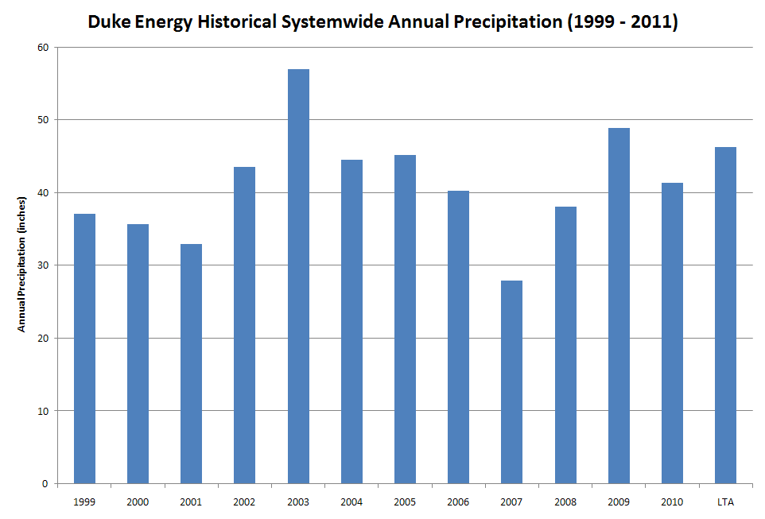
Precipitation
122%
105%
Only 2 years in the last 12 have had above long term average rainfall amounts. Is this a
long term drought period?

Slide 4
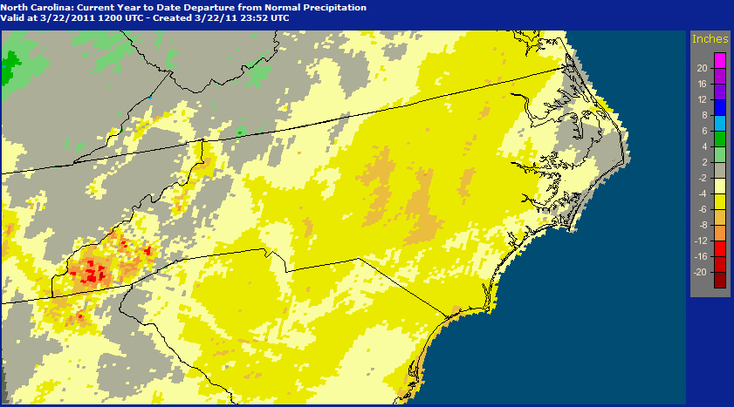
Precipitation: Departure from normal for the period Jan 1 – Mar 22, 2011
Note that Central North Carolina generally remains below average for precipitation in 2011.

Slide 5
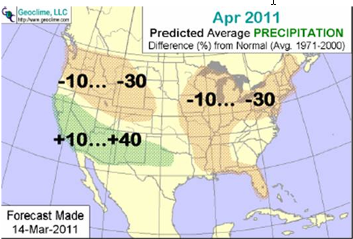
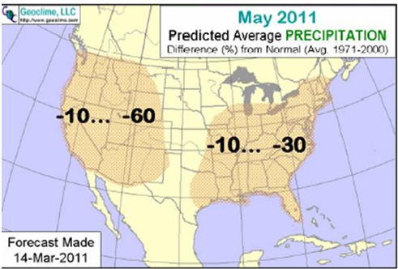
April – May Outlook 2011: Near normal conditions transitioning to drier conditions.

Slide 6
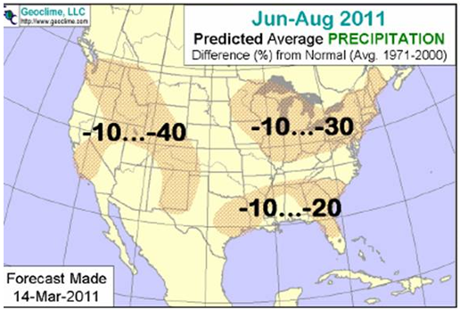
Summer Forecast June – August 2011: Near normal conditions.

Slide 7
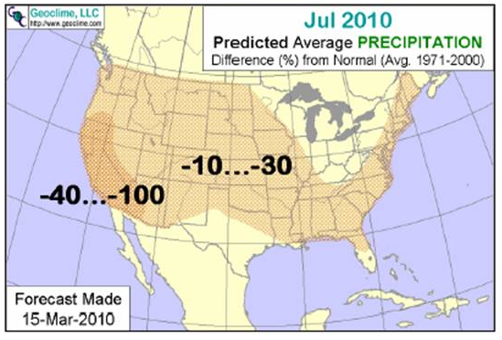
Long Range Forecast July 2010: 10 to 30 % below Normal Precipitation.

Slide 8
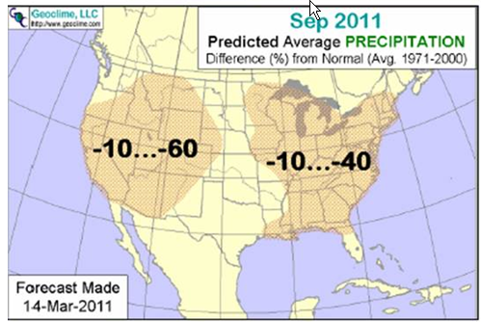
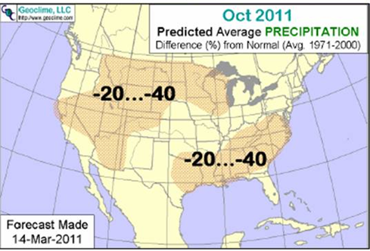
Fall Forecast September – October 2011: Below average conditions.

Slide 9
Synopsis:
Below average conditions leading into spring
Not a lot of guidance on what the summer will bring though the fall
looks to be dry.
Tropical season could have above normal activity.
Duke Energy Operations Summary:
Manage lakes to target levels.
Watch forecast signals.

